Slide 1
Configuring S3 Event Notifications with SNS

Slide 2
Objective:-
The goal of this project is to implement an automated, event-driven architecture using Amazon S3, Amazon SNS (Simple Notification Service), and Amazon SQS (Simple Queue Service). By configuring S3 to trigger notifications for specific events—such as file uploads, deletions, or modifications—and routing those events through an SNS topic to an SQS queue, this setup enables real-time alerting, decoupled message processing, and scalable downstream integrations.

Slide 3
Scope of project:-
Set up an Amazon S3 bucket.
Create an Amazon SNS topic.
Link S3 event notifications to SNS.
Create an Amazon SQS queue and subscribe it to the SNS topic.
Test by uploading/deleting objects in S3.
Verify message delivery from S3 → SNS → SQS.

Slide 4
List of services integrated:-
Amazon S3 (Simple Storage Service):
Primary Service where the events (such as file uploads, deletions, or modifications) are triggered.
S3 event notifications will be configured to listen for specific actions within the bucket.
Amazon SNS (Simple Notification Service):
Notification Service used to send messages about the events in S3.
SNS topic will be used as the destination for the S3 event notifications, and SNS will forward the message to subscribed endpoints (SQS, email, Lambda, etc.).
Amazon SQS (Simple Queue Service);
Queueing Service used to store and manage event messages reliably between services.
SQS will receive messages from the SNS topic (as a subscribed endpoint), allowing for asynchronous processing.

Slide 5
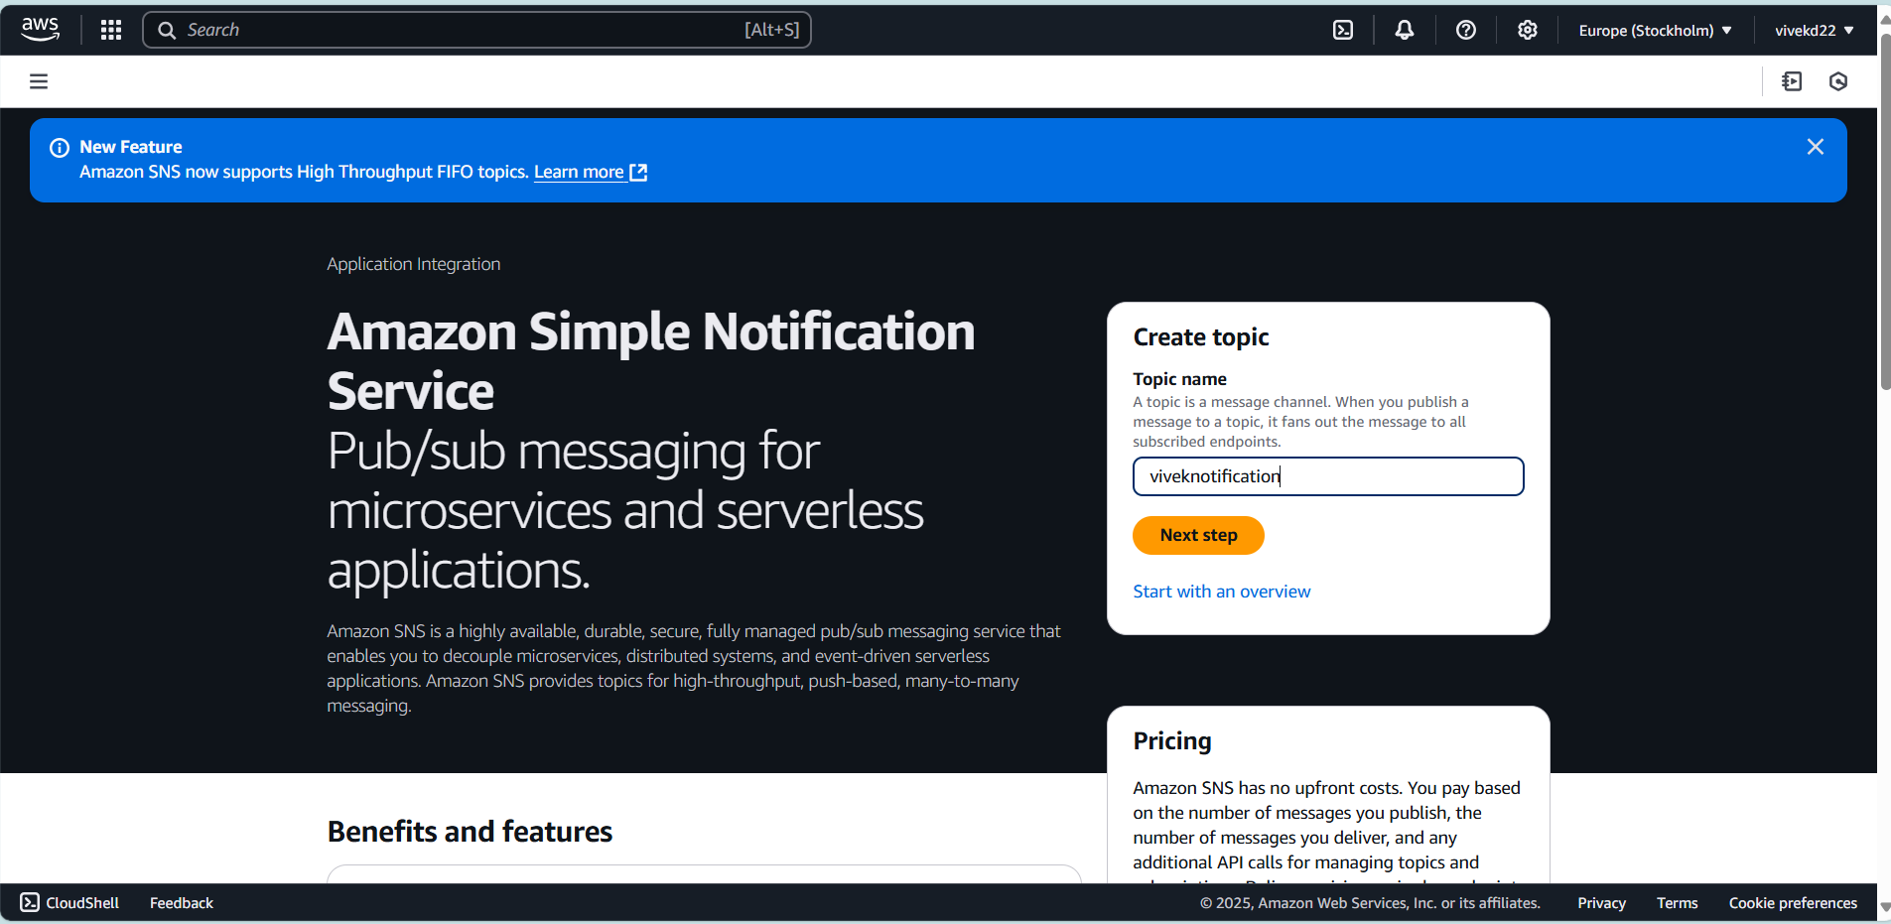
Create sns(simple notification service):-

Slide 6
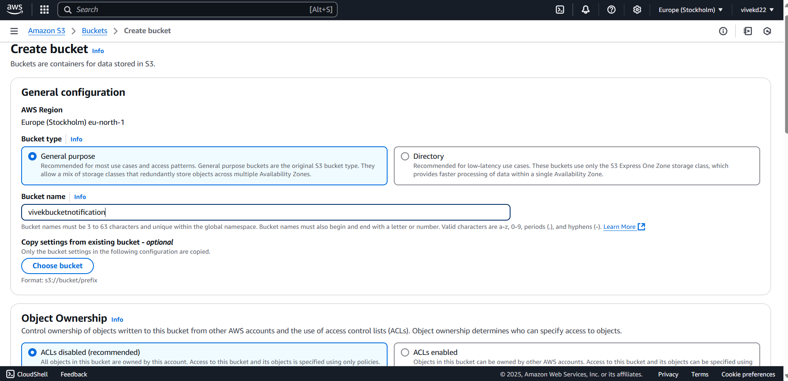
Create S3 bucket:-

Slide 7
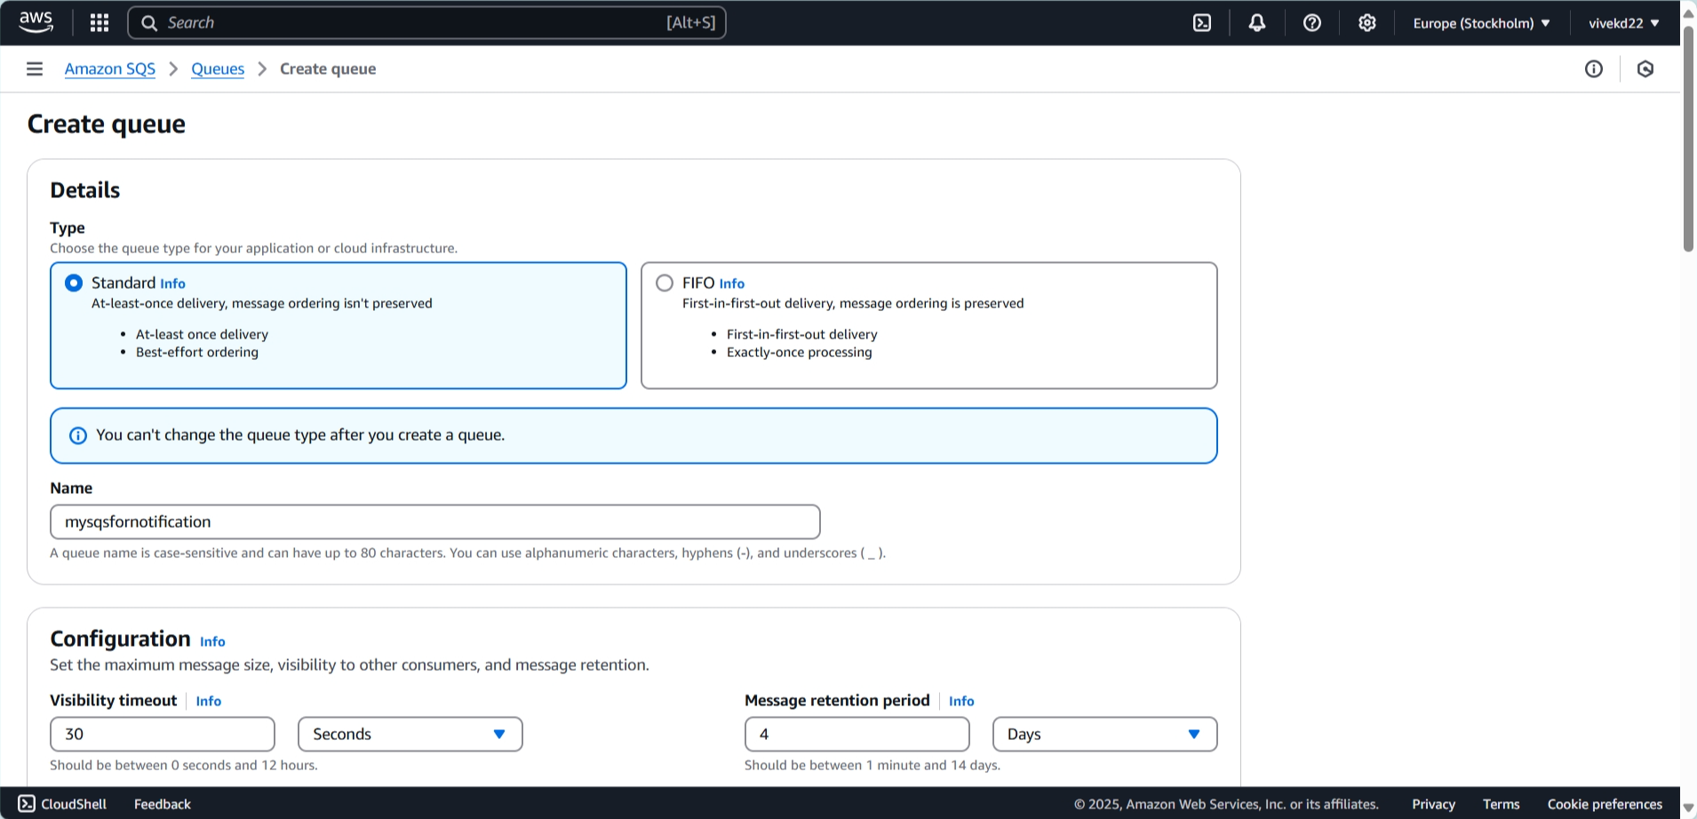
Create SQS(simple query service)

Slide 8
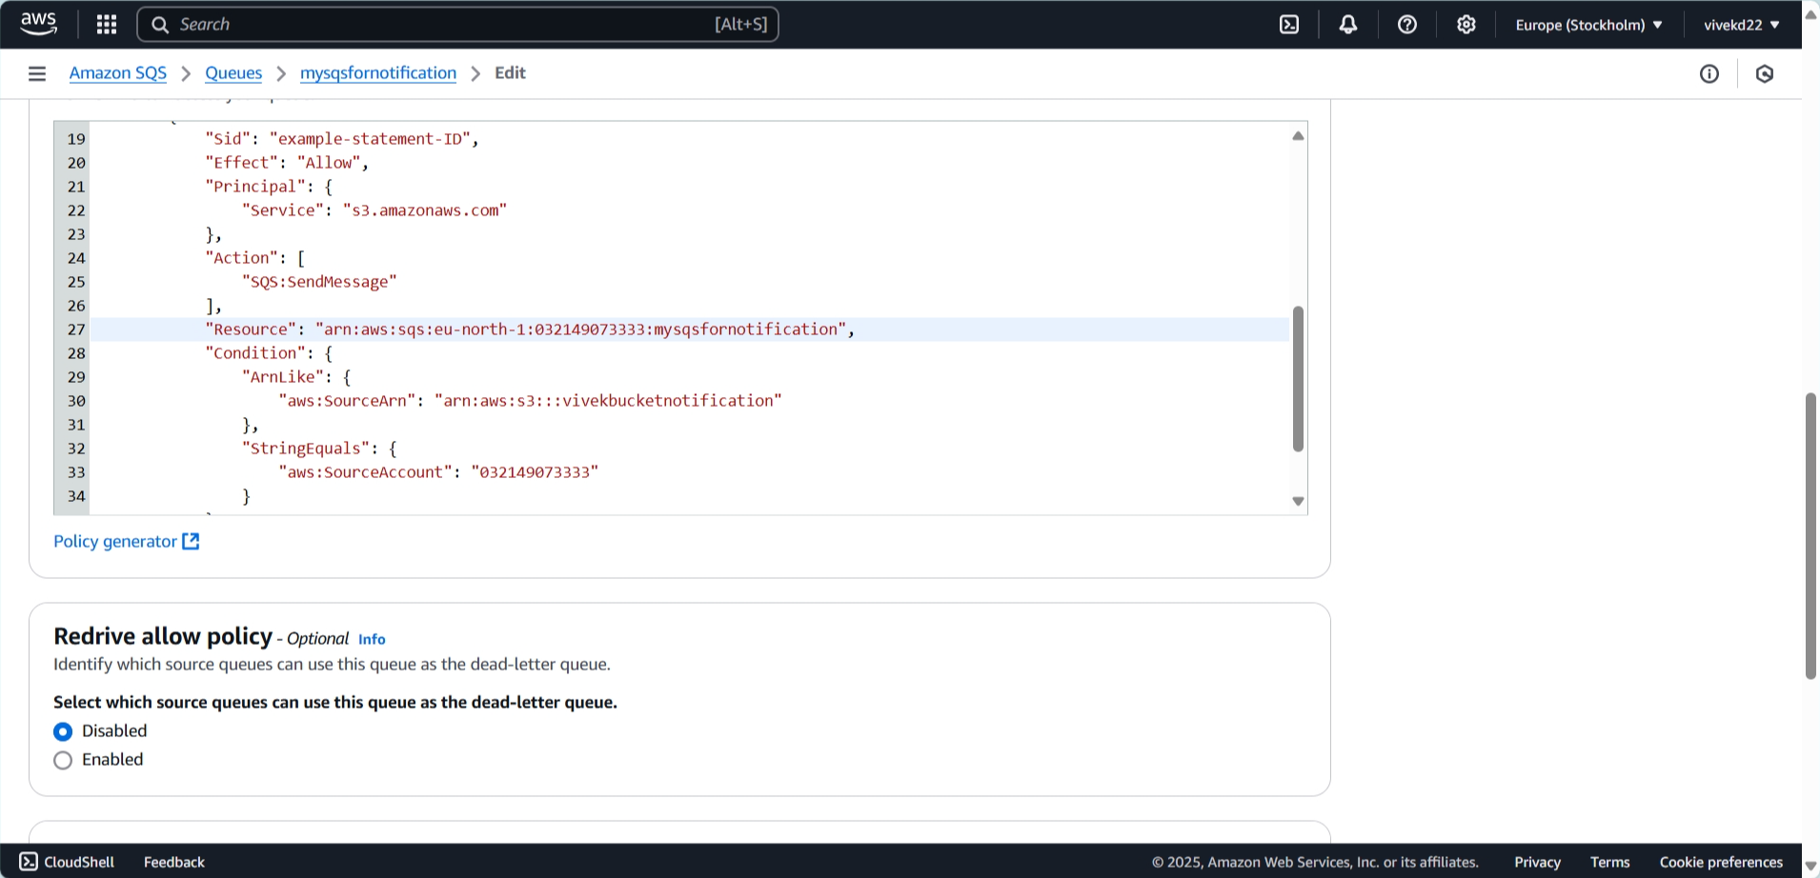
Update the SqS access policy to allow the S3 bucket to publish event notifications.:-

Slide 9
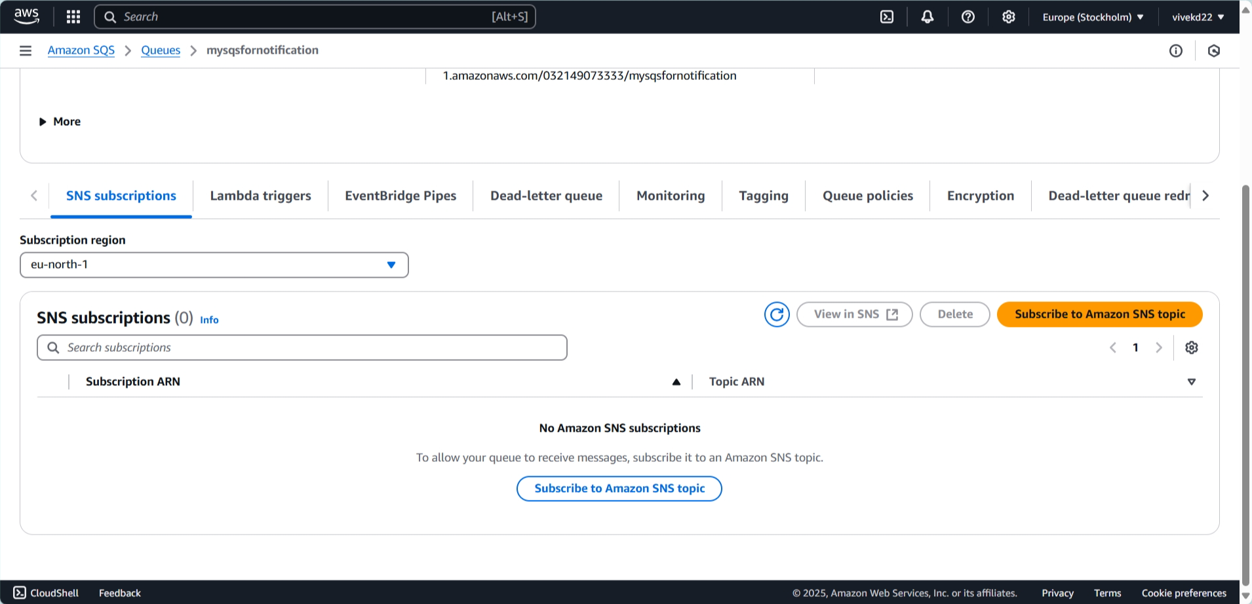
Create subscription:-

Slide 10
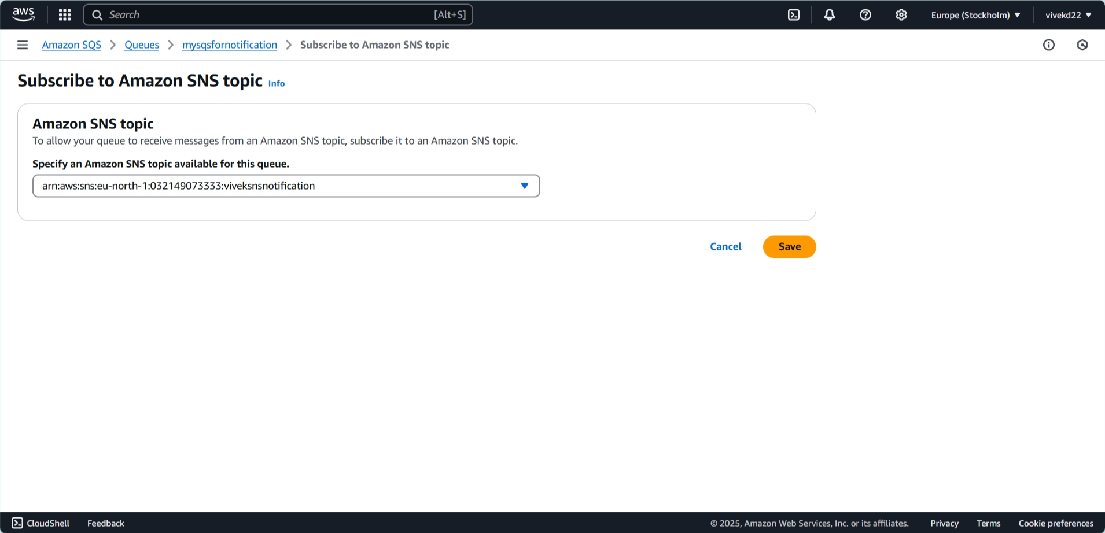

Slide 11
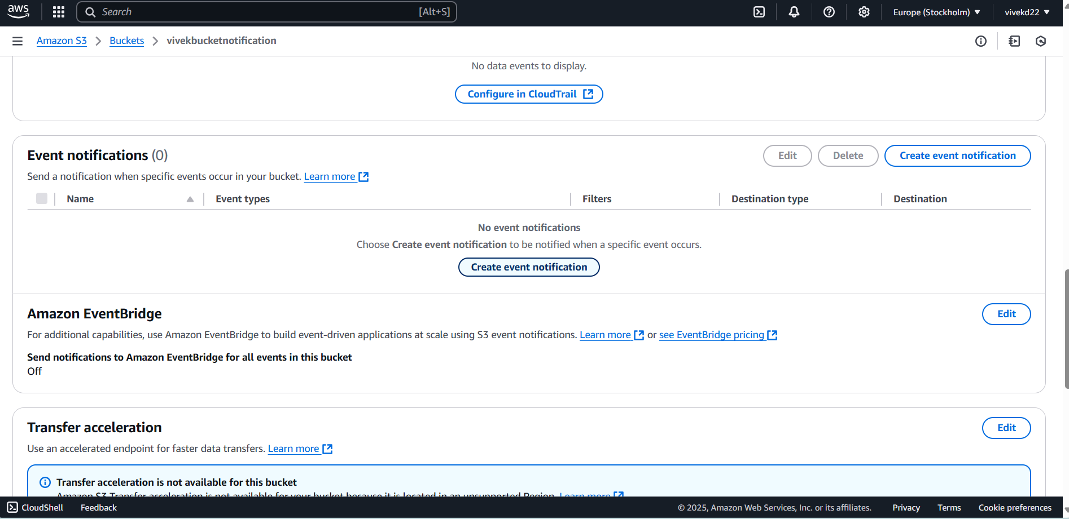
Add SQS as a Notification Destination for S3 Bucket Events:-

Slide 12
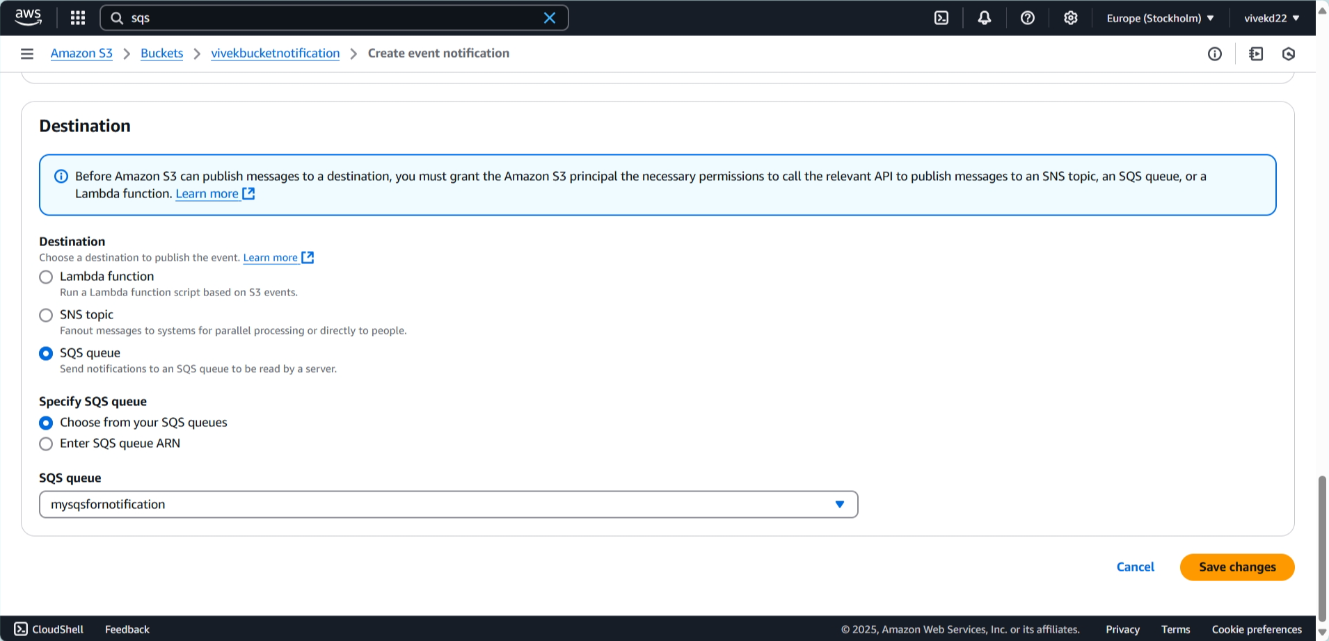

Slide 13
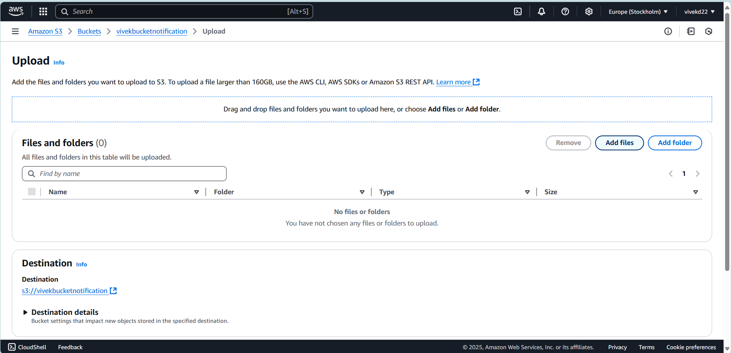
Add files to receive message :-

Slide 14
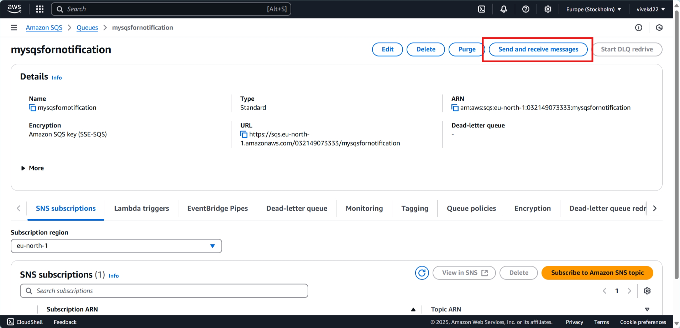
Click on send and receive message:-

Slide 15
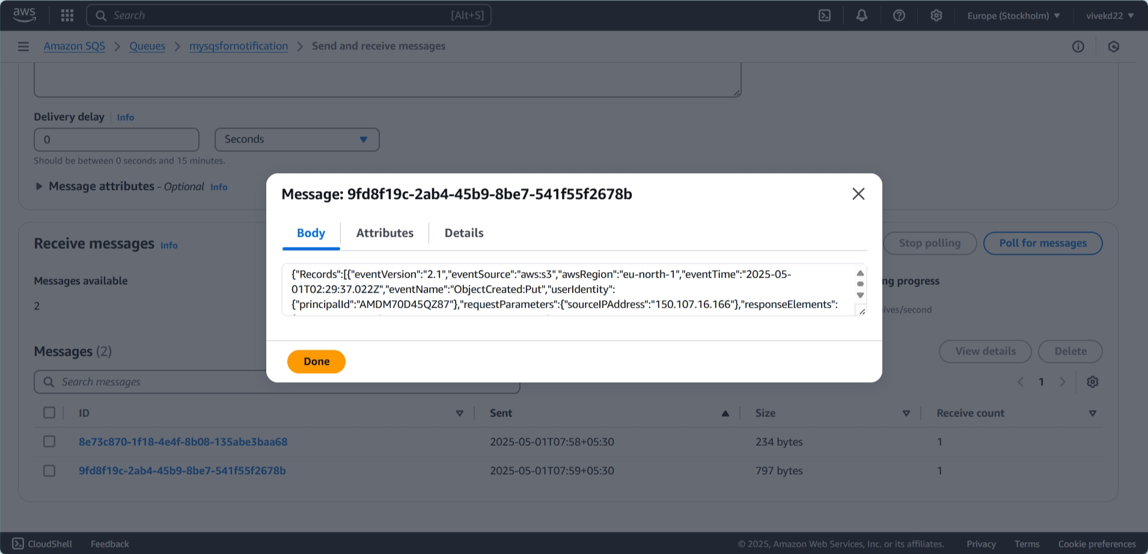
received message after adding the file:-

Slide 16
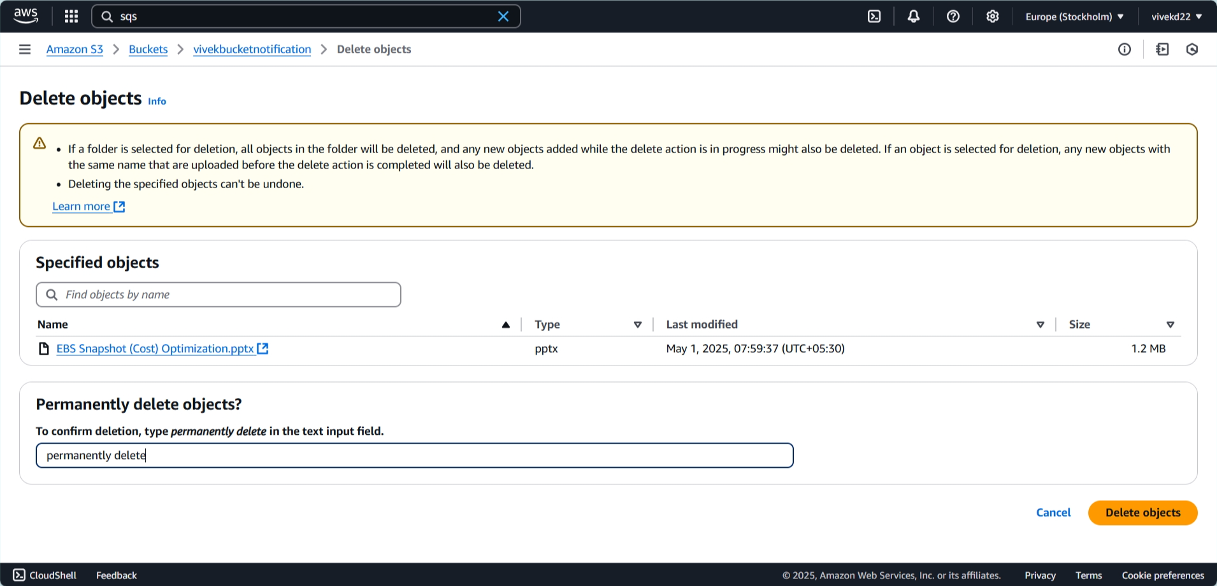
Delete added file to receive message:-

Slide 17
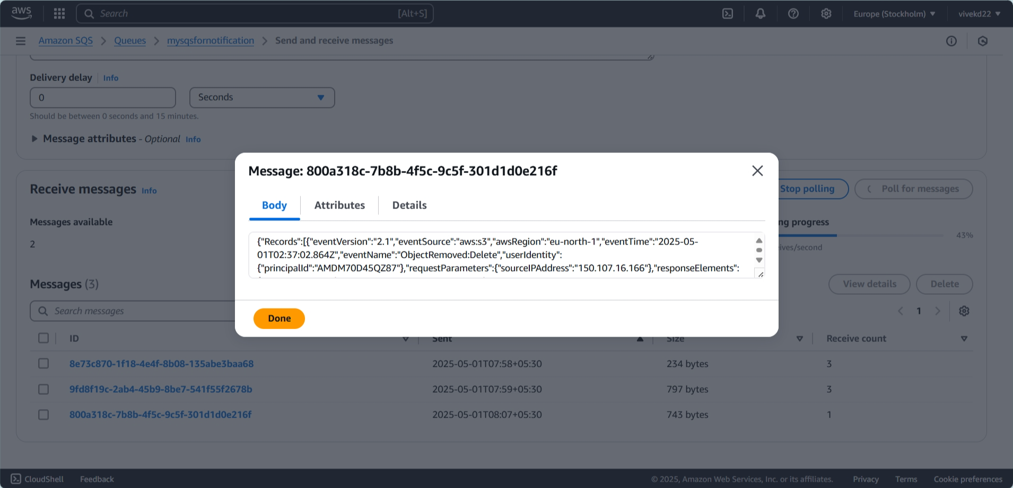
Received message after deleting the file:-

Slide 18
Thank you Project by vivek Mukund deve

